Slide 1

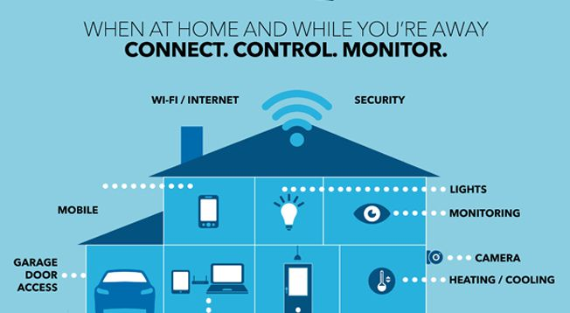
CONNECTED HOME ENVIRONMENT MONITORING SYSTEM
Presented by:
N Prudhvi Reddy
141FA05099
Under The Guidance Of:
Dhanasudakar Vasudevan, Vadamalai Ganesh Paramasivam &
Ashline George
1
Internal | RBEI/BSP1 | 2018-05-02
© Robert Bosch Engineering and Business Solutions Private Limited 2018. All rights reserved, also regarding any disposal, exploitation, reproduction, editing, distribution, as well as in the event of applications for industrial property rights.
© Robert Bosch Engineering and Business Solutions Private Limited 2018. All rights reserved, also regarding any disposal, exploitation, reproduction, editing, distribution, as well as in the event of applications for industrial property rights.

Slide 2
CONTENTS
INTRODUCTION
ABOUT THE PROJECT
USE CASES
BLOCK DIAGRAM
REQUIREMENT
ANDROID APP
FINAL PRODUCT
REFERENCE
2
Internal | RBEI/BSP1 | 2018-05-02
© Robert Bosch Engineering and Business Solutions Private Limited 2018. All rights reserved, also regarding any disposal, exploitation, reproduction, editing, distribution, as well as in the event of applications for industrial property rights.

Slide 3
Introduction
Internet means connecting a computer to any other computer anywhere in the world via dedicated routers and servers.
Smart home technology gives you ultimate control over your home for in by automating for instance the lighting system, dimming , electrical appliances, audio and security systems.
3
Internal | RBEI/BSP1 | 2018-05-02
© Robert Bosch Engineering and Business Solutions Private Limited 2018. All rights reserved, also regarding any disposal, exploitation, reproduction, editing, distribution, as well as in the event of applications for industrial property rights.

Slide 4
INTERNET OF THINGS
Internet is not only just connecting people but also connecting things.
IOT is a system of interrelated computing devices ,mechanical devices.
The ability to transfer the data over a network without requiring human to human, human to computer interaction.
4
Internal | RBEI/BSP1 | 2018-05-02
© Robert Bosch Engineering and Business Solutions Private Limited 2018. All rights reserved, also regarding any disposal, exploitation, reproduction, editing, distribution, as well as in the event of applications for industrial property rights.

Slide 5
About the project
Objective of this project is to monitor indoor air quality and security in the home .
Our device will able to detect different types of Gases like carbon dioxide, oxygen, LPG in Home.
Home temperature will also be detect by this device.
If the temperature level Exceeds then it will give a notification.
When an person visits the home as the door bell is rung by him/her and picture of that person will be snapped immediately ,which can be viewed through an app or mail services
When some motion is detected by the web camera then picture will be snapped.
Features:
Motion detection and photo capture using the camera.
Mobile notifications with photos.
5
Internal | RBEI/BSP1 | 2018-05-02
© Robert Bosch Engineering and Business Solutions Private Limited 2018. All rights reserved, also regarding any disposal, exploitation, reproduction, editing, distribution, as well as in the event of applications for industrial property rights.

Slide 6
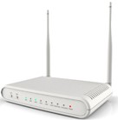

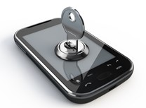
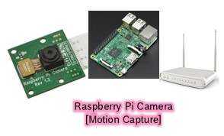
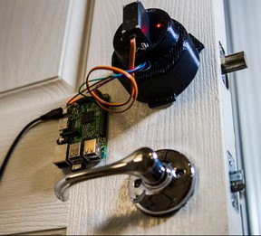

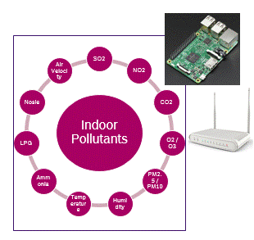
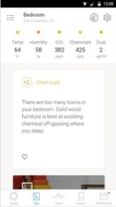
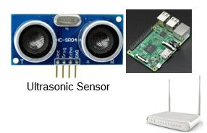

Connected Home - Use cases
Remote Visitor Alert
Remote Lock / Unlock
Indoor Pollutants Monitoring
Utility Monitoring & Controlling
6
6
Overhead tank water level
Internal | RBEI/BSP1 | 2018-05-02
Internal | RBEI/BSP1 | 2018-05-02
© Robert Bosch Engineering and Business Solutions Private Limited 2018. All rights reserved, also regarding any disposal, exploitation, reproduction, editing, distribution, as well as in the event of applications for industrial property rights.

Slide 7
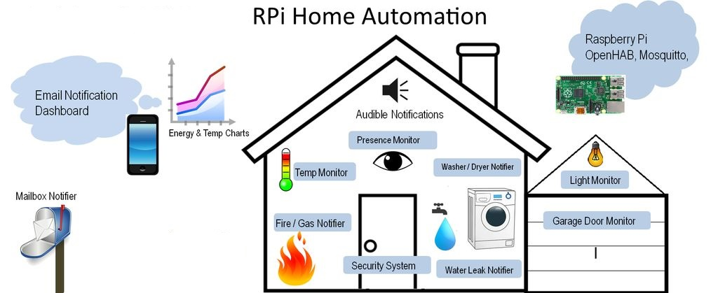
Block Diagram
7
Internal | RBEI/BSP1 | 2018-05-02
© Robert Bosch Engineering and Business Solutions Private Limited 2018. All rights reserved, also regarding any disposal, exploitation, reproduction, editing, distribution, as well as in the event of applications for industrial property rights.

Slide 8
Requirements
Hardware requirements
Raspberry pi
Sensors
Bread board
Connecting wires
Push Button
Web camera
Software requirements
Raspbian
SMTP
Java JDK
Android studio
Emulator
8
Internal | RBEI/BSP1 | 2018-05-02
© Robert Bosch Engineering and Business Solutions Private Limited 2018. All rights reserved, also regarding any disposal, exploitation, reproduction, editing, distribution, as well as in the event of applications for industrial property rights.

Slide 9
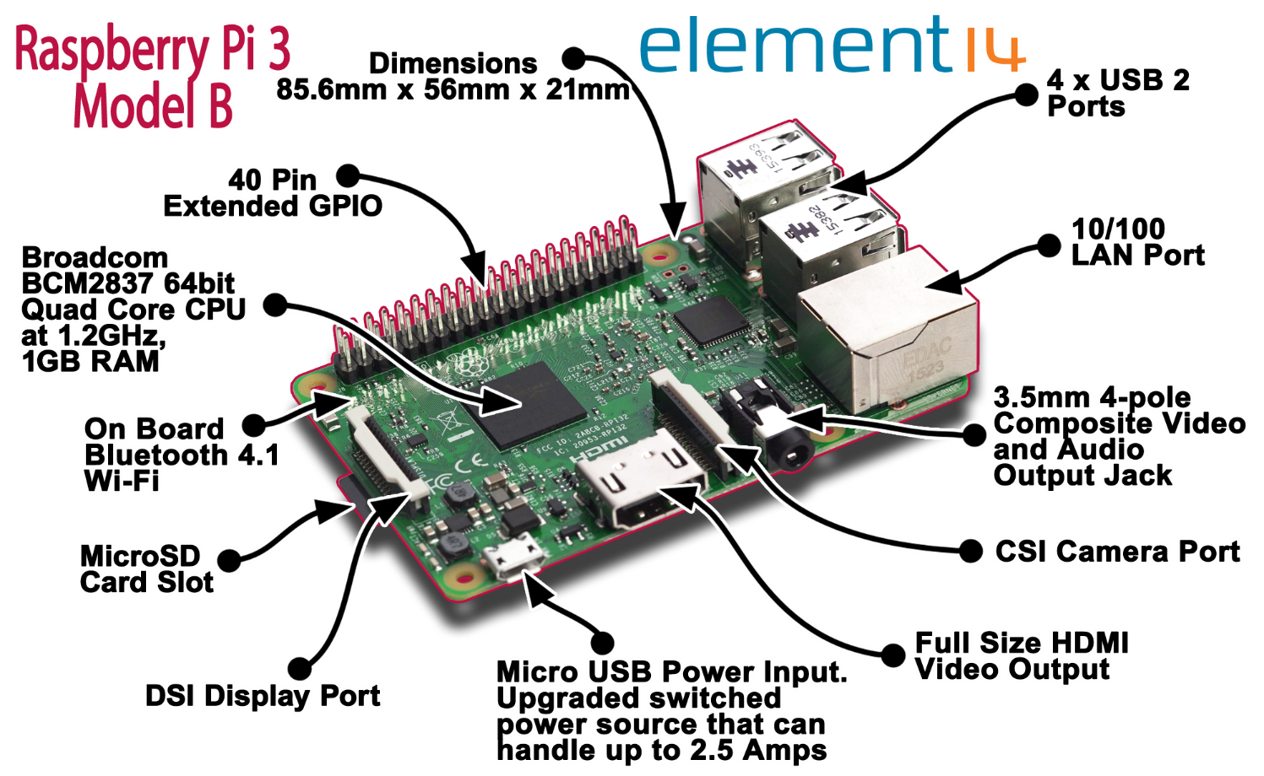
Raspberry Pi
9
Internal | RBEI/BSP1 | 2018-05-02
© Robert Bosch Engineering and Business Solutions Private Limited 2018. All rights reserved, also regarding any disposal, exploitation, reproduction, editing, distribution, as well as in the event of applications for industrial property rights.

Slide 10
Raspberry Pi
The purpose of pi was to create a low-cost device that would improve programming skills and hardware understanding at the pre-university level.
It is a credit-card sized computer designed for education.
The Raspberry Pi is slower than a modern laptop or desktop but is still a complete Linux computer and can provide all the expected abilities that implies, at a low-power consumption level.
10
Internal | RBEI/BSP1 | 2018-05-02
© Robert Bosch Engineering and Business Solutions Private Limited 2018. All rights reserved, also regarding any disposal, exploitation, reproduction, editing, distribution, as well as in the event of applications for industrial property rights.

Slide 11
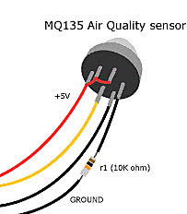
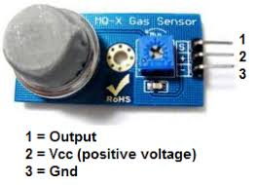
Sensors
Carbon dioxide-cozIR,K-30,MQ-135
LPG-MQ2
Temperature-Grove DHT 22
(digital humidity and temperature),
DS18B20
11
Internal | RBEI/BSP1 | 2018-05-02
© Robert Bosch Engineering and Business Solutions Private Limited 2018. All rights reserved, also regarding any disposal, exploitation, reproduction, editing, distribution, as well as in the event of applications for industrial property rights.

Slide 12
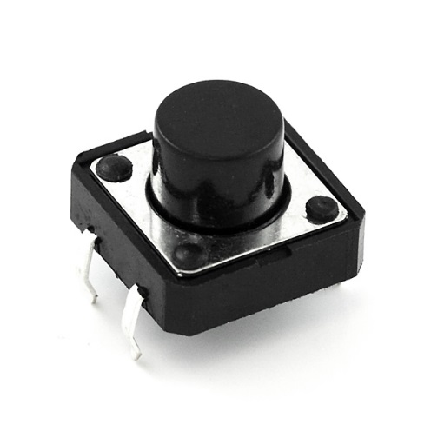
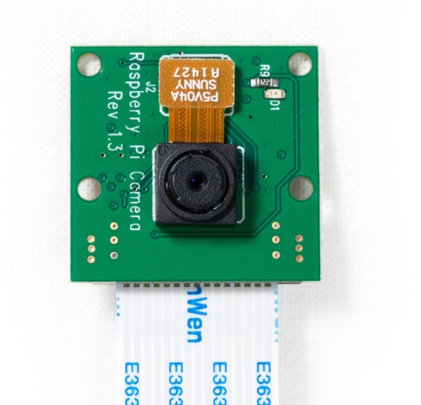
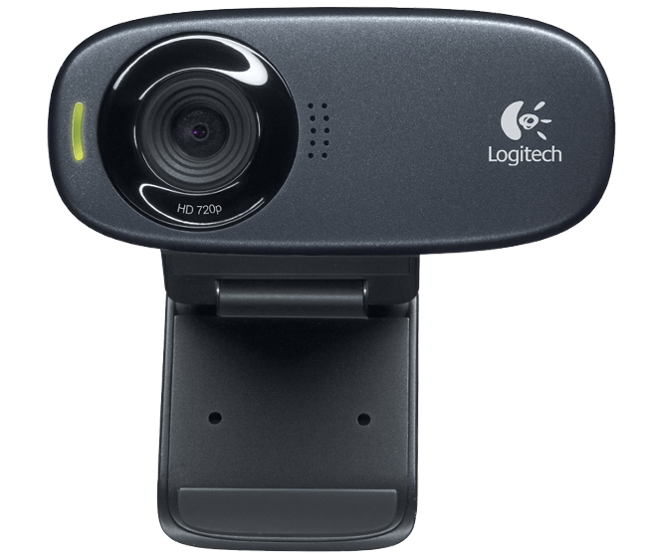
Devices
Usb camera/pi camera
Push button
Usb camera
Push Button
Pi Camera
12
Internal | RBEI/BSP1 | 2018-05-02
© Robert Bosch Engineering and Business Solutions Private Limited 2018. All rights reserved, also regarding any disposal, exploitation, reproduction, editing, distribution, as well as in the event of applications for industrial property rights.

Slide 13
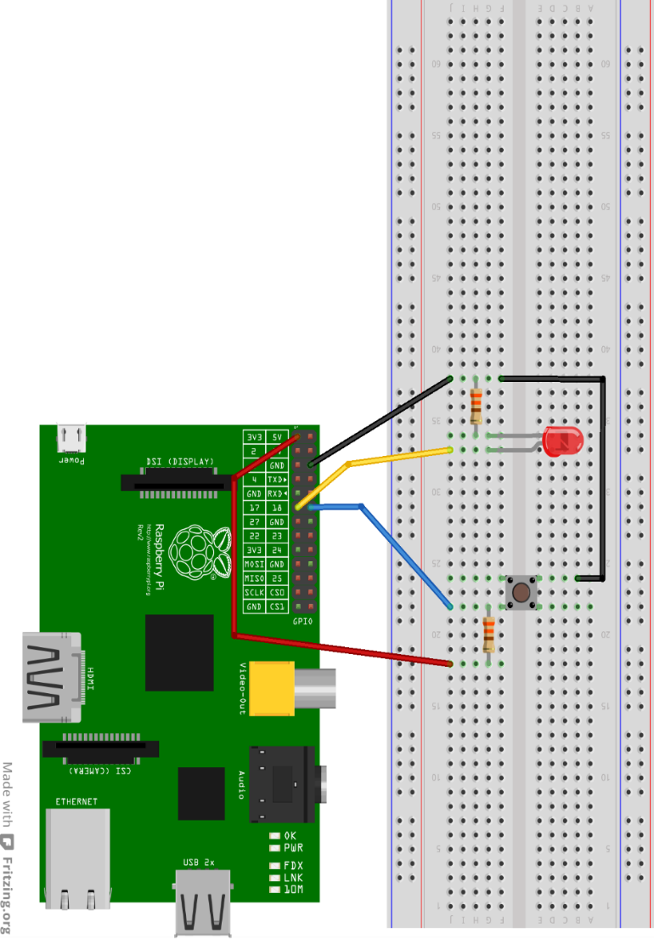
Push button:
. A push button is a simple type of switch that controls an action in a machine or some type of process.
. The push button is connected to raspberry pi by using the bread board it acts as a medium between raspberry pi and push button.
13
Internal | RBEI/BSP1 | 2018-05-02
© Robert Bosch Engineering and Business Solutions Private Limited 2018. All rights reserved, also regarding any disposal, exploitation, reproduction, editing, distribution, as well as in the event of applications for industrial property rights.

Slide 14
Web camera:
. A webcam is a small digital video camera directly or indirectly connected to a computer or a computer network.
. To install the web camera libraries in raspberry pi by using the following command.
sudo apt-get install fswebcam
. The picture will be taken by using webcam and saved to the file name as we specified.
fswebcam image.jpg
14
Internal | RBEI/BSP1 | 2018-05-02
© Robert Bosch Engineering and Business Solutions Private Limited 2018. All rights reserved, also regarding any disposal, exploitation, reproduction, editing, distribution, as well as in the event of applications for industrial property rights.

Slide 15
Web camera:
. To specify the resolution of webcam by using the following command.
fswebcam –r 1280*720 image.jpg
Installing motion lib
sudo apt-get install motion
Installing smtp lib
sudo apt-get install ssmtp
15
Internal | RBEI/BSP1 | 2018-05-02
© Robert Bosch Engineering and Business Solutions Private Limited 2018. All rights reserved, also regarding any disposal, exploitation, reproduction, editing, distribution, as well as in the event of applications for industrial property rights.

Slide 16
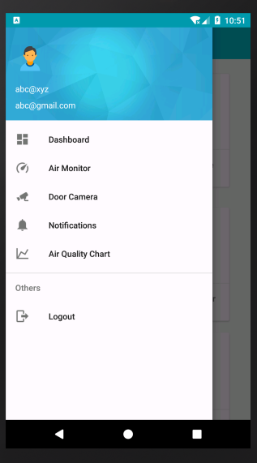
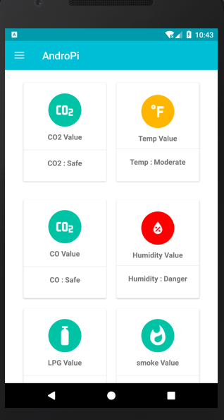
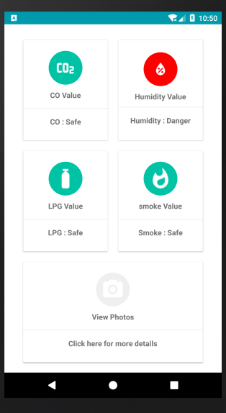
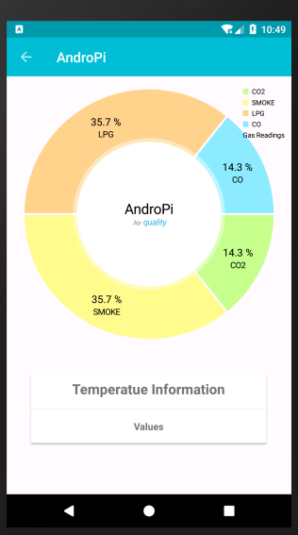
Android App
16
Internal | RBEI/BSP1 | 2018-05-02
© Robert Bosch Engineering and Business Solutions Private Limited 2018. All rights reserved, also regarding any disposal, exploitation, reproduction, editing, distribution, as well as in the event of applications for industrial property rights.

Slide 17
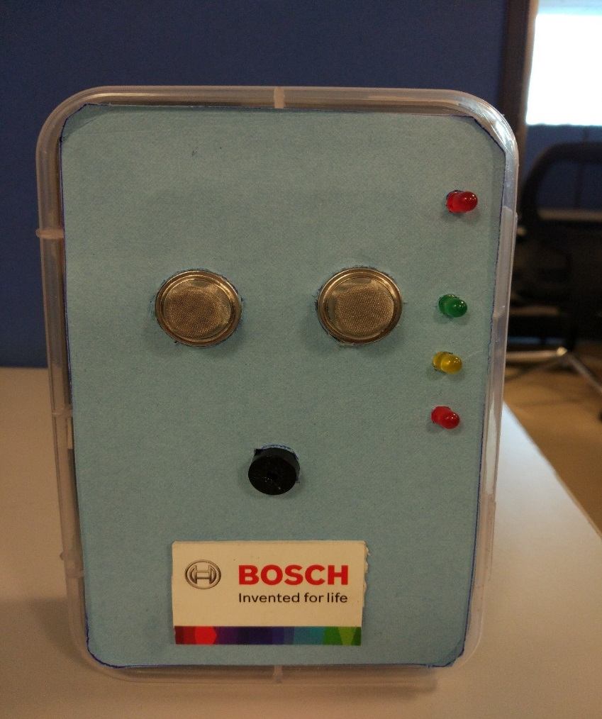
Final product
17
Internal | RBEI/BSP1 | 2018-05-02
© Robert Bosch Engineering and Business Solutions Private Limited 2018. All rights reserved, also regarding any disposal, exploitation, reproduction, editing, distribution, as well as in the event of applications for industrial property rights.

Slide 18
REFERENCE
[1] https://circuitdigest.com/microcontroller-projects/raspberry-pi-surveillance-camera.
[2] http://www.raspberry-projects.com/pi/software_utilities/email/ssmtp-to-send-emails
[3] https://tutorials-raspberrypi.com/configure-and-read-out-the-raspberry-pi-gas-sensor-mq- x/
[4] http://www.instructables.com/id/Raspberry-PI-and-DHT22-temperature-and-humidity-lo/
[5] https://docs.microsoft.com/en-us/azure/storage/
[6] https://docs.pivotal.io
[7] https:// firebase.google.com/docs/
[8] https:// www.raspberrypi.org
18
Internal | RBEI/BSP1 | 2018-05-02
© Robert Bosch Engineering and Business Solutions Private Limited 2018. All rights reserved, also regarding any disposal, exploitation, reproduction, editing, distribution, as well as in the event of applications for industrial property rights.

Slide 19
THANK YOU
19
Internal | RBEI/BSP1 | 2018-05-02
© Robert Bosch Engineering and Business Solutions Private Limited 2018. All rights reserved, also regarding any disposal, exploitation, reproduction, editing, distribution, as well as in the event of applications for industrial property rights.

